Slide 1


Slide 2
Difference Between Multiplexing & Multiple access:
Multiplexing combines multiple signals from one source into a single channel, while multiple access allows several users to share a single channel.
1. Multiplexing
Goal: Combine multiple signals → send through one channel.
Used in: Communication between two points (point-to-point).
Focus: Efficient use of channel bandwidth.
Examples:
  TDM (Time Division Multiplexing)
  FDM (Frequency Division Multiplexing)
  WDM (Wavelength Division Multiplexing)
Analogy:
Like several TV channels sharing one cable using different frequencies.
2. Multiple Access
Goal: Allow multiple users to access the same medium at the same time.
Used in: Communication in networks, where many users share the channel.
Focus: Efficient sharing of a common medium.
Examples:
  TDMA (Time Division Multiple Access)
  FDMA (Frequency Division Multiple Access)
  CDMA (Code Division Multiple Access)
  OFDMA (Orthogonal Frequency Division Multiple Access)
Analogy:
Many people speaking through different “slots” or “codes” on the same network.

Slide 3
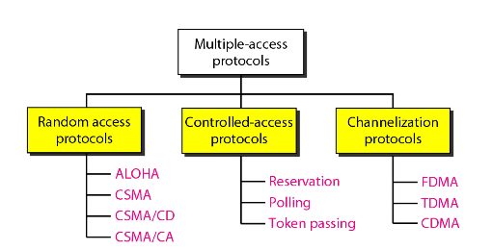

Slide 4
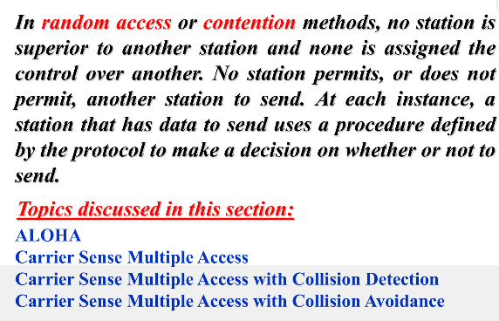

Slide 5
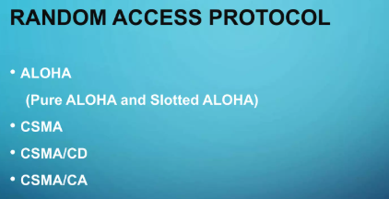

Slide 6
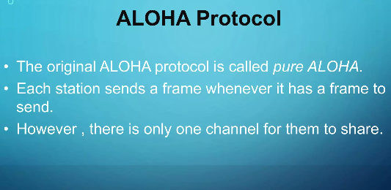

Slide 7
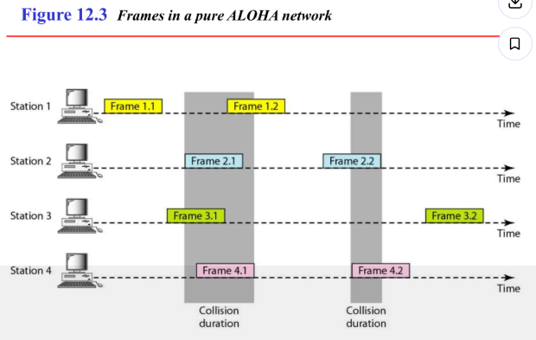

Slide 8
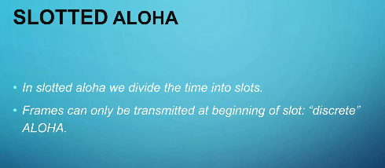
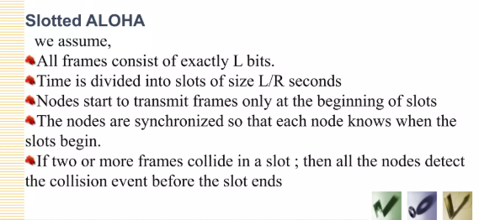

Slide 9
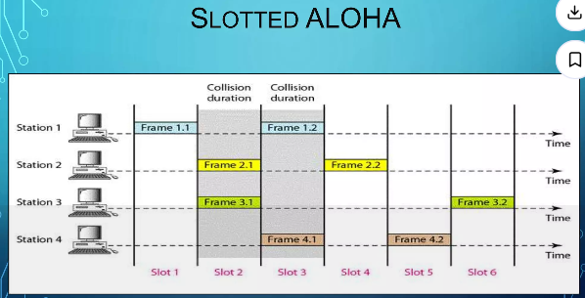

Slide 10
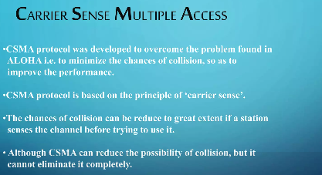

Slide 11
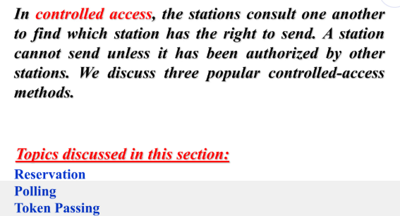

Slide 12
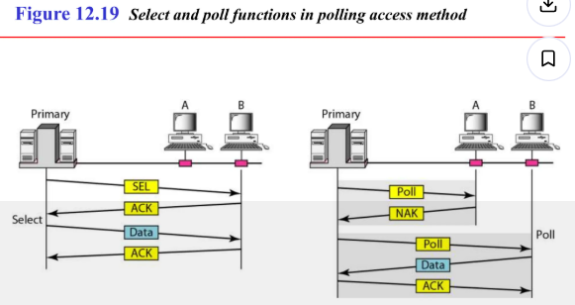

Slide 13
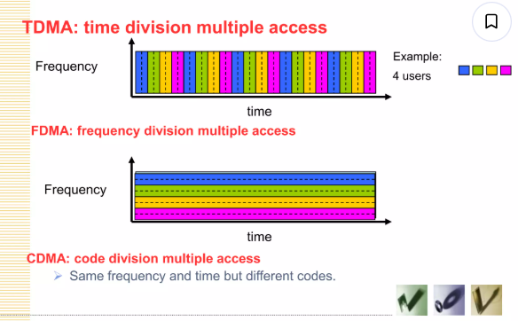

Slide 14
More Questions:
1. Explain the OSI and TCP/IP reference models in detail. Discuss the functions of each layer, comparing how they handle data communication.
2. Describe how different networking devices—hub, switch, repeater, bridge, router, and gateway—operate at various layers of these models.

